Slide 1
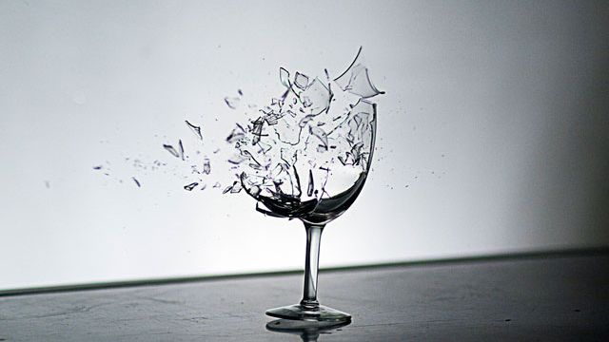
BREAK THE GLASSES!!
Team: 希望弄得破

Slide 3
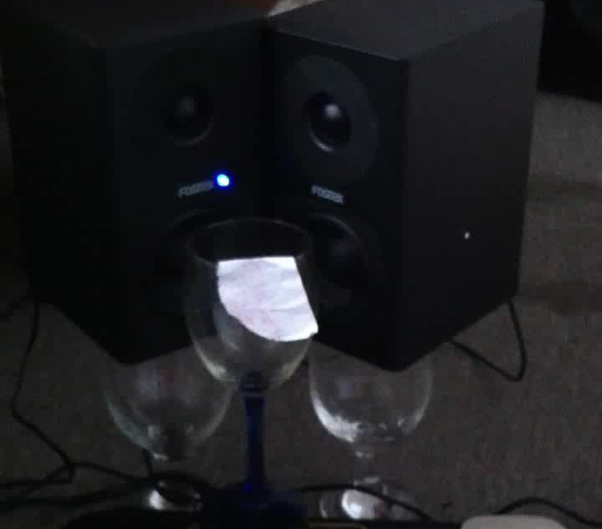
Resonance frequency detection and
vibration creation: glass breaking demo

Slide 4
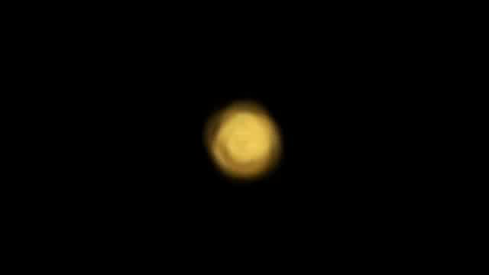
Resonance frequency detection and
vibration creation: glass breaking demo

Slide 5

Background Knowledge
Resonance
Γ: 阻尼係數
Ω: 共振頻率
ω: 驅動頻率

Slide 6
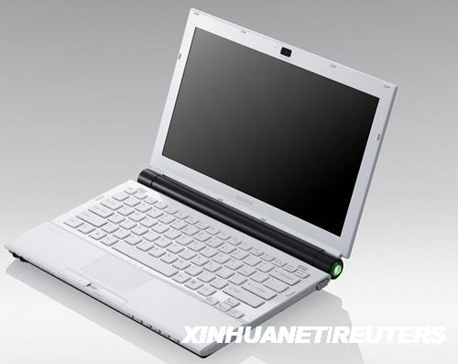
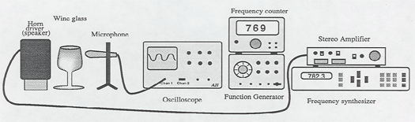
Background Knowledge

Slide 7
But …
Glasses:
should have a very strong resonance
Loudness:
Around 135-140dB
Pitch:
Right around the pitch
THE XXXX GLASSES!!!!

Slide 8
PIVOT
Simulate with program
Consider
Pitch
Cumulation of energy
Dissipation of energy

Slide 9
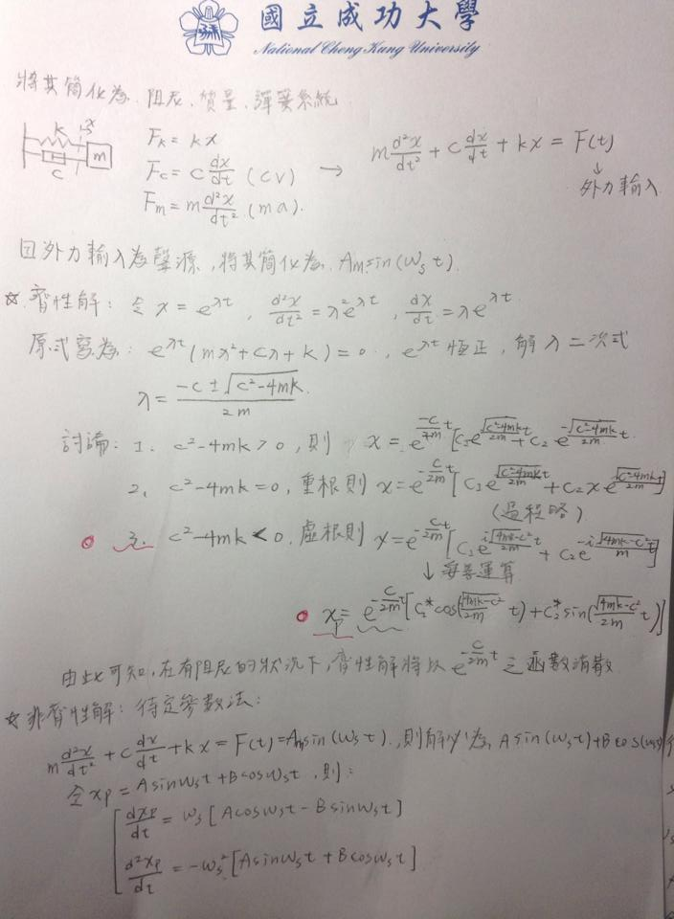
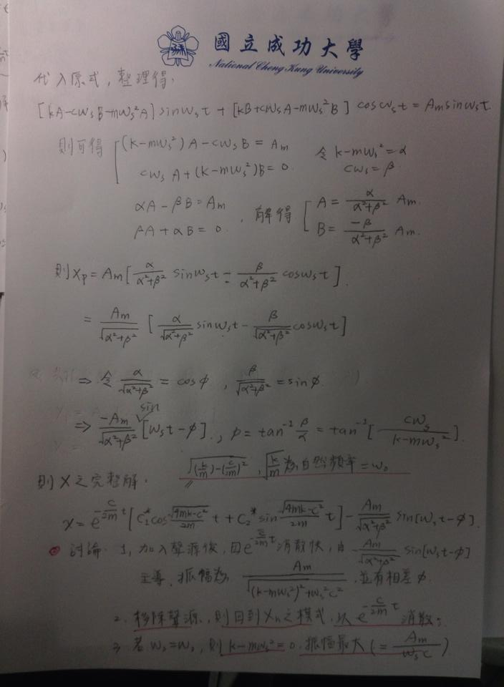

Slide 10
Pitch
Real record from the glasses
Use dsp system toolbox to adjust

Slide 11
Cumulation
energy(i)*
1/(abs(1-(f(i)/glassPitch)^2)+difficulty)

Slide 12
Dissipation of energy
energy(i)*
X^((-C)/2* Γ * Γ)

Slide 13


Slide 14
唱破玻璃遊戲

Slide 15
實作方法
1.聽音高：
(1)錄摩玻璃杯所發出的聲音
(2)利用shiftPitch調整到目標pitch

Slide 16
2.震破玻璃杯：
(1)錄人唱的聲音
(2)利用volume(i)*1/(abs(1-(f(i)/glassPitch)^2)+difficulty)
來模擬在玻璃杯中累積的能量

Slide 17
關於(2) 模擬玻璃杯中累積的能量
1.計算pitch
2.把wave檔轉成frame
3.計算volume
4.套入公式volume(i)*1/(abs(1-(f(i)/glassPitch)^2)+difficulty)
計算能量，其中difficulty是我們自己定義的難易程度常數

